Slide 1
Module 2
Database Design

Slide 2
Database design and Normalisation
Normalization works through a series of stages called normal forms. The first three stages are described as first normal form (1NF), second normal form (2NF), and third normal form (3NF). From a structural point of view, 2NF is better than 1NF, and 3NF is better than 2NF. For most purposes in business database design, 3NF is as high as you need to go in the normalization process. However, you will discover that properly designed 3NF structures also meet the requirements of fourth normal form (4NF).
But, you should not assume that the highest level of normalization is always the most desirable.
Generally, the higher the normal form, the more relational join operations are required to produce a specified output and the more resources are required by the database system to respond to end-user queries.
A successful design must also consider end-user demand for fast performance. Therefore, you will occasionally be expected to denormalize some portions of a database design in order to meet performance requirements. Denormalization produces a lower normal form; that is, a 3NF will be converted to a 2NF through denormalization
The table is the basic building block of database design.
How do you recognize a poor table structure?
How do you produce a good table?
Solution :NORMALISATION
Normalization is a process for evaluating and correcting table structures to minimize data redundancies, thereby reducing the likelihood of data anomalies.

Slide 3
Objective of Normalization
􏰛 Each table represents a single subject. For example, a course table will contain only data that directly pertain to courses. Similarly, a student table will contain only student data. 􏰛 No data item will be unnecessarily stored in more than one table (in short, tables have minimum controlled redundancy). The reason for this requirement is to ensure that the data are updated in only one place. 􏰛 All non-prime attributes in a table are dependent on the primary key—the entire primary key and nothing but the primary key. The reason for this requirement is to ensure that the data are uniquely identifiable by a primary key value. 􏰛 Each table is void of insertion, update, or deletion anomalies. This is to ensure the integrity and consistency of the data.
A B C D
A: prime
B,C,D : Non prime attribute
A → BCD

Slide 4
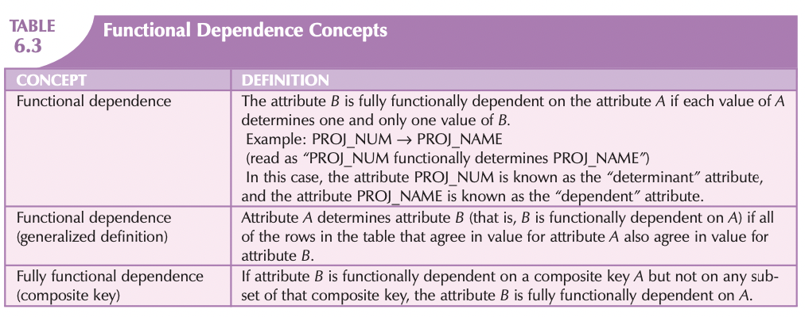
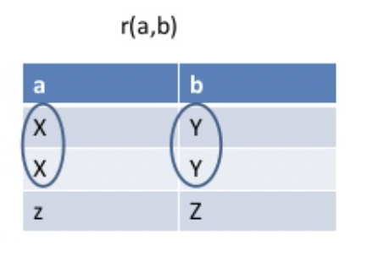
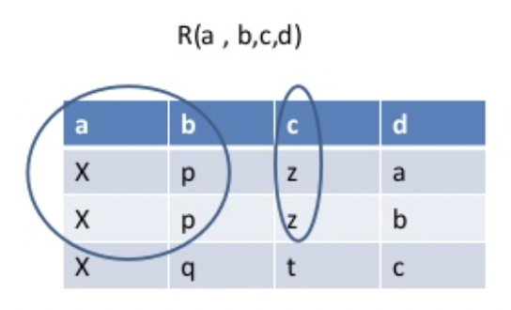
Dependency concepts
a → b
If t1[a] = t2[a]
;
t1[b]= t2[b]
a,b → c a,b -> c ✅
a -> b X a,b -> d X
abc -> d X
b -> c ✅

Slide 5
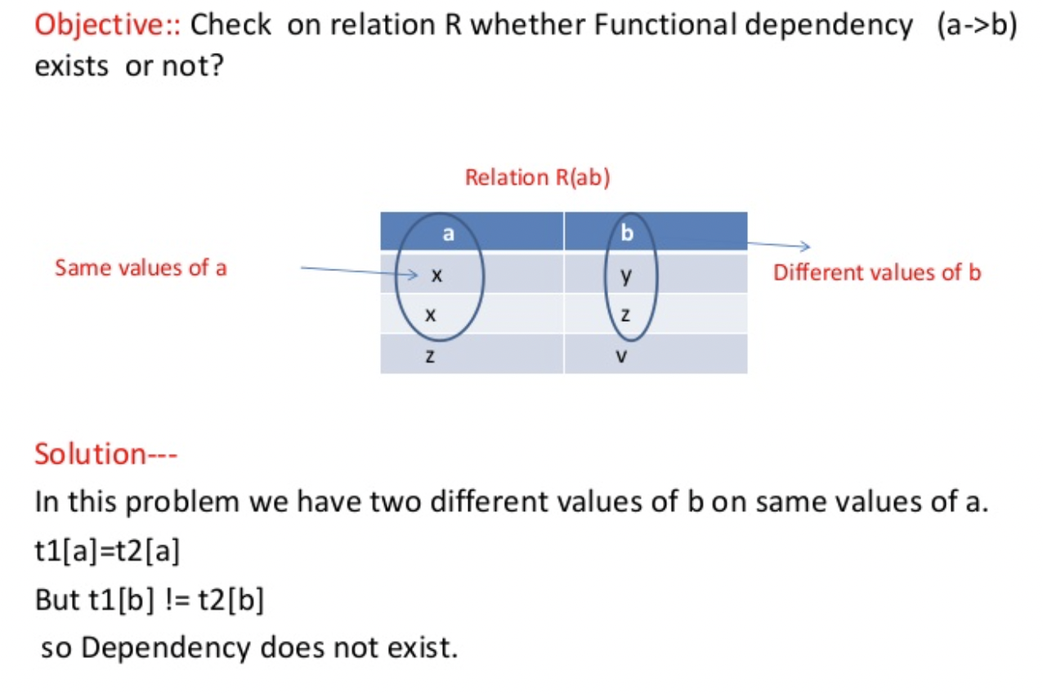

Slide 6
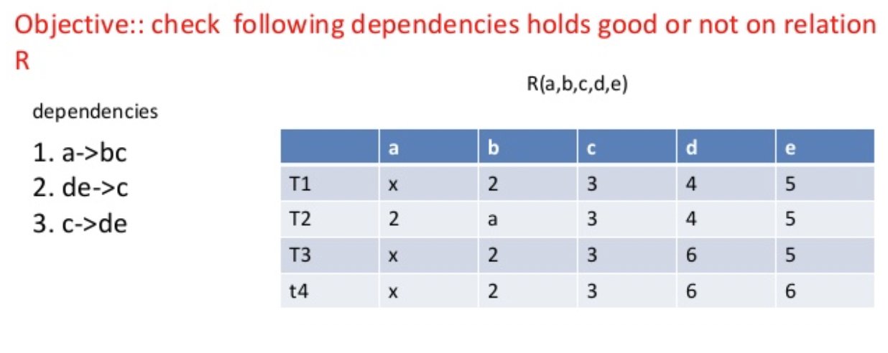
✅
✅
x

Slide 7
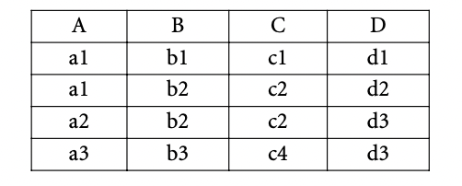
Home Work
Compute all functional Dependencies in above Table

Slide 8
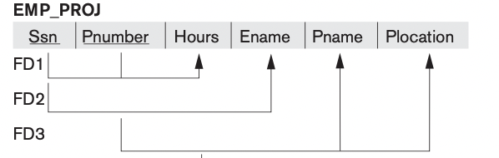
Partial Dependency
Student_ID | Sub_ID | Marks | Teacher
1 | 1 | 30 | English
1 | 2 | 40 | Maths
2 | 1 | 50 | English
3 | 1 | 40 | English
A partial dependency exists when there is a functional dependence in which the determinant is only part of the primary key (remember we are assuming there is only one candidate key).
For example, if (A, B) → (C,D), B → C, and (A, B) is the primary key, then the functional dependence B → C is a partial dependency because only part of the primary key (B) is needed to determine the value of C.
Partial dependencies tend to be rather straightforward and easy to identify.
Here Student_ID + Sub_ID can be considered as key because both together can Identify marks
Also they can Identify Teacher too
BUT, Sub_ID alone can determine Teacher
Sub_ID → Teacher {Partial Dependence}
Consider the following:
Seller(Id, Product, Price)
Candidate Key : Id, Product
Non prime attribute : Price
Price attribute only depends on only Product attribute which is a subset of candidate key, Not the whole candidate key(Id, Product) key . It is called partial dependency.
So we can say that Product->Price is partial dependency.

Slide 9
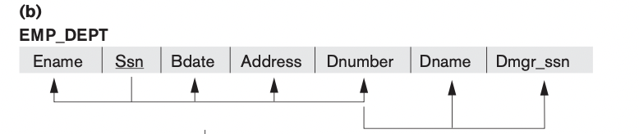
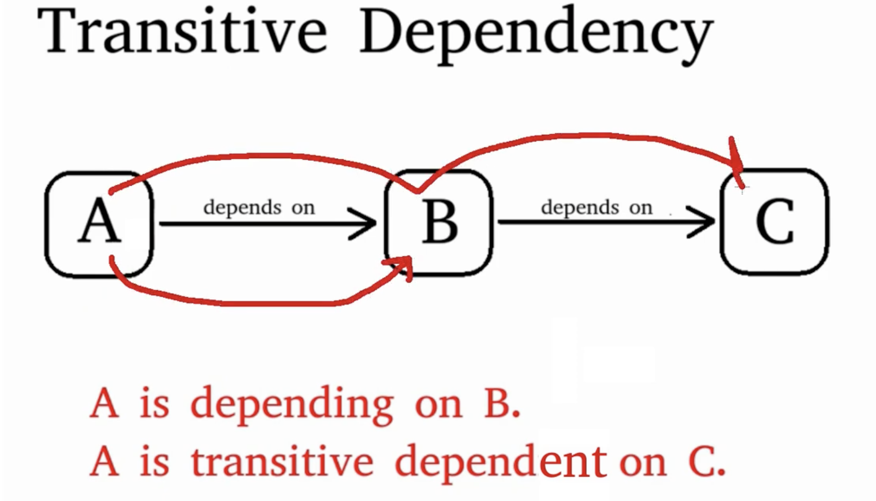
Transitive Dependency
x=y ; y = z => x=z
x->y ; y -> z ; x->z
A transitive dependency exists when there are functional dependencies such that X → Y, Y → Z, and X is the primary key. In that case, the dependency X → Z is a transitive dependency because X determines the value of Z via Y
A transitive dependency will occur only when a functional dependence exists among nonprime attributes. In the previous example, the actual transitive dependency is X → Z. However, the dependency Y → Z signals that a transitive dependency exists.

Slide 10
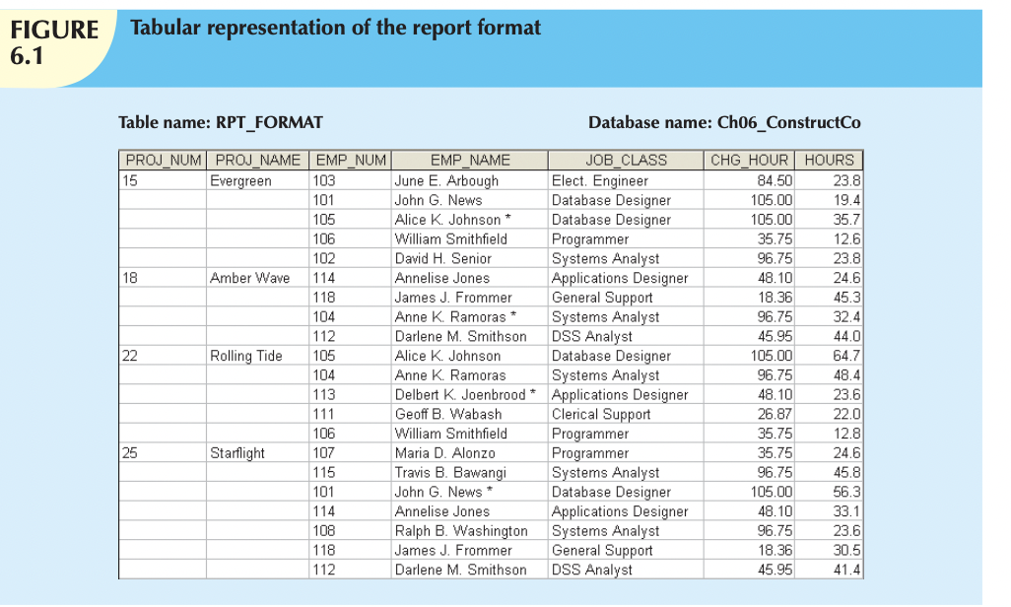
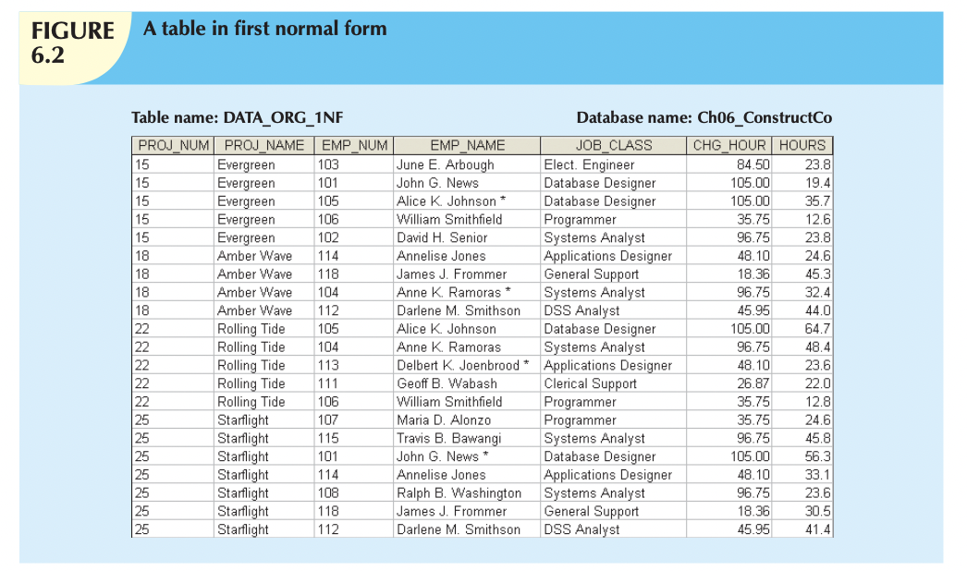
First Normal Form(1 NF)
Step1: Eliminate Repeating Groups

Slide 11
SSN | Name | Ph. | Salary
123 | shm | 995637 | 20000
123 | shm | 98789 | 20000
SSN | Name | ph1 | ph2 | salary
123 | shm | 9957 | 9987 | 2000
345 | sim | 987 | NULL | 3000
1234 | jn. | jn, | NULL | 4000

Slide 12
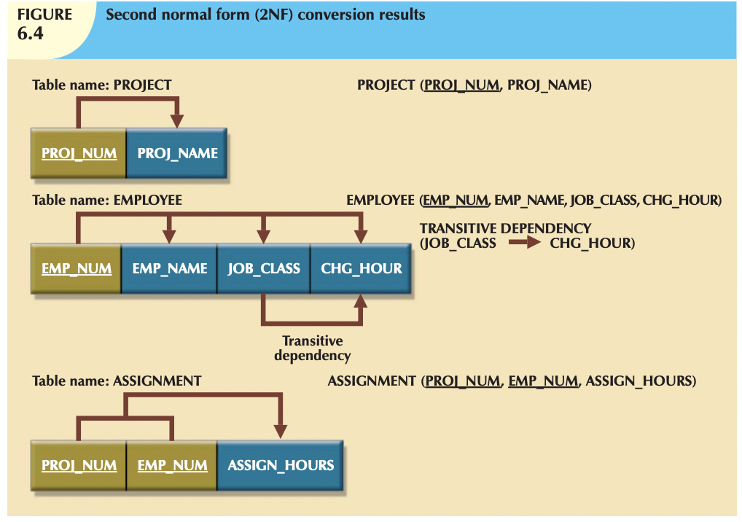
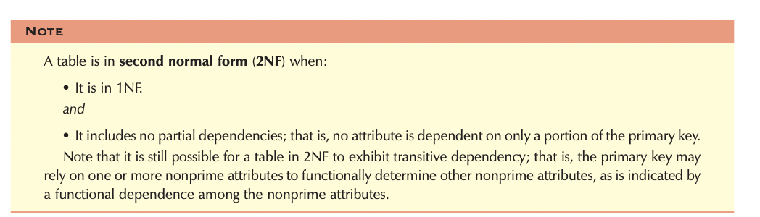
Second Normal Form
Step 2: Reassign Corresponding Dependent Attributes
Step 1: Make New Tables to Eliminate Partial Dependencies

Slide 13
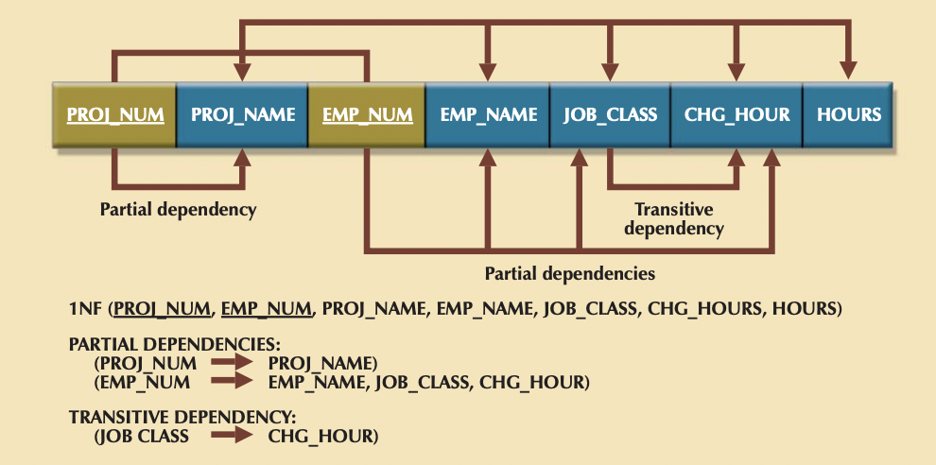
Step 2: Identify Primary Key
Step 3: Identify all Dependencies
Projects
PROJ_NUM, EMP_NUM → PROJ_NAME, EMP_NAME, JOB_CLASS, CHG_HOUR, HOURS
Proj_Num | Proj_Name
Empdetails
Emp_num | emp_name | Jobclass | Chg hr
Assigned_Hrs
Emp_num | Proj_Num | Hours

Slide 14
Identifying Primary Key
R(ABCDE)
A → D, D→ B, B → C, E→ B
R(A,B,C)
A→ B , B → C
Closures
(AB)⁺ = ABDC
(AC)⁺ = ACDB
(AD)⁺ = ADCB
(AE)⁺ = AEDBC
A⁺= ADBC
B⁺ = BC
C⁺ = C
D⁺ = DBC
E⁺ = EBC
R(A,B,C,D)
AB→ C , C → B
R(A,B,C,D)
AB→ C, C→ B, C→ D

Slide 15
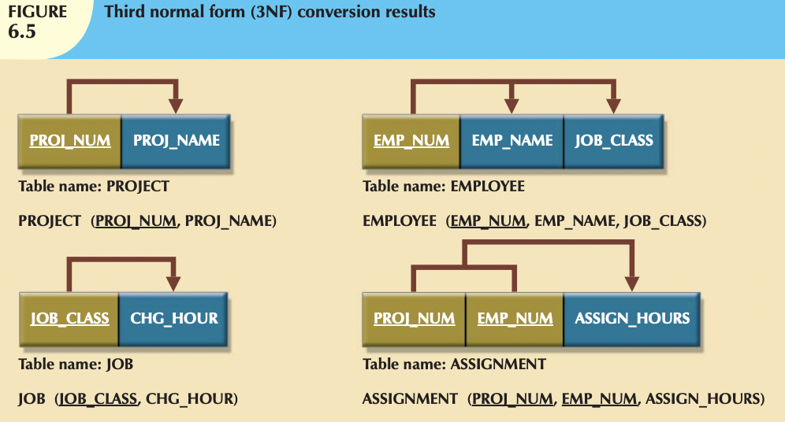
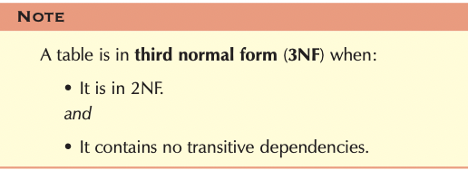
Third Normal form
Step 1: Make New Tables to Eliminate Transitive Dependencies
Step 2: Reassign Corresponding Dependent Attributes

Slide 16
Improving the Design
The addition of a JOB_CODE attribute produces the dependency:
JOB_CODE → JOB_CLASS, CHG_HOUR
Note that the new JOB table now has two candidate keys—JOB_CODE and JOB_CLASS. In this case, JOB_CODE is the chosen primary key as well as a surrogate key
An artificial PK introduced by the designer with the purpose of simplifying the assignment of primary keys to tables. Surrogate keys are usually numeric, they are often automatically generated by the DBMS, they are free of semantic content (they have no special meaning), and they are usually hidden from the end users.
Evaluate Primary Key(PK) Assignments
Here, we have JOB_CLASS → CHG_HRS
Entering DB Designer instead of Database Designer for the JOB_CLASS attribute in the EMPLOYEE table will trigger Referential Integrity Violations

Slide 17
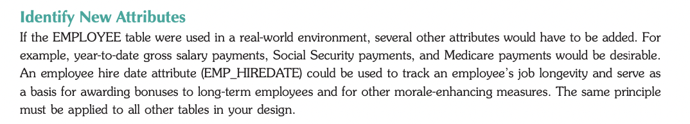
Evaluating Naming Conventions
Refine Attribute Atomicity
Atomicity requirement : An atomic attribute is one that cannot be further subdivided. Such an attribute is said to display atomicity.
Clearly, the use of the EMP_NAME in the EMPLOYEE table is not atomic because EMP_NAME can be decomposed into a last name, a first name, and an initial. By improving the degree of atomicity, you also gain querying flexibility
CHG_HOUR can be changed to JOB_CHG_HOUR to indicate its association with the JOB table .

Slide 18
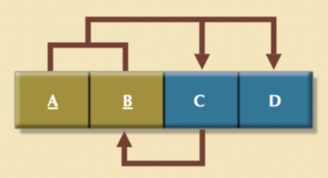
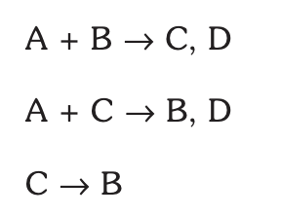
BCNF
To be in BCNF,
3NF + LHS should be candidate key / super key

Slide 19
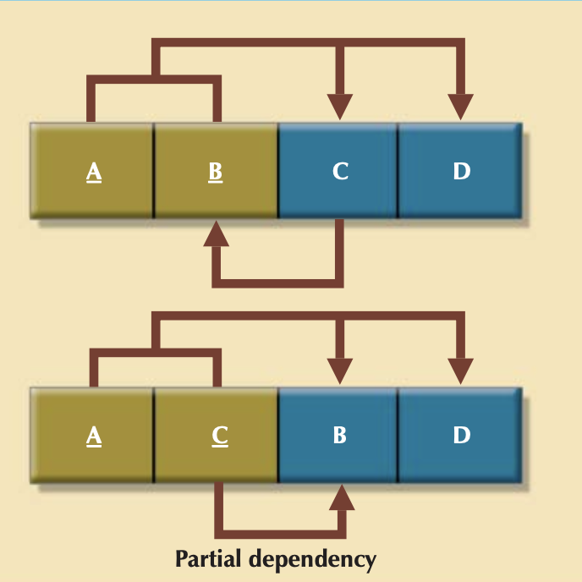
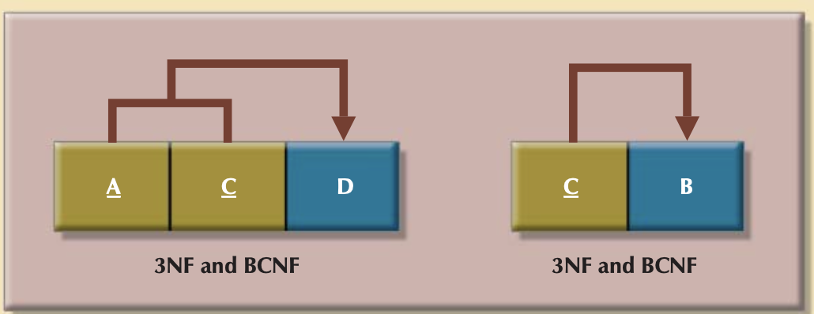
Decomposition to BCNF

Slide 20
4NF

Slide 21
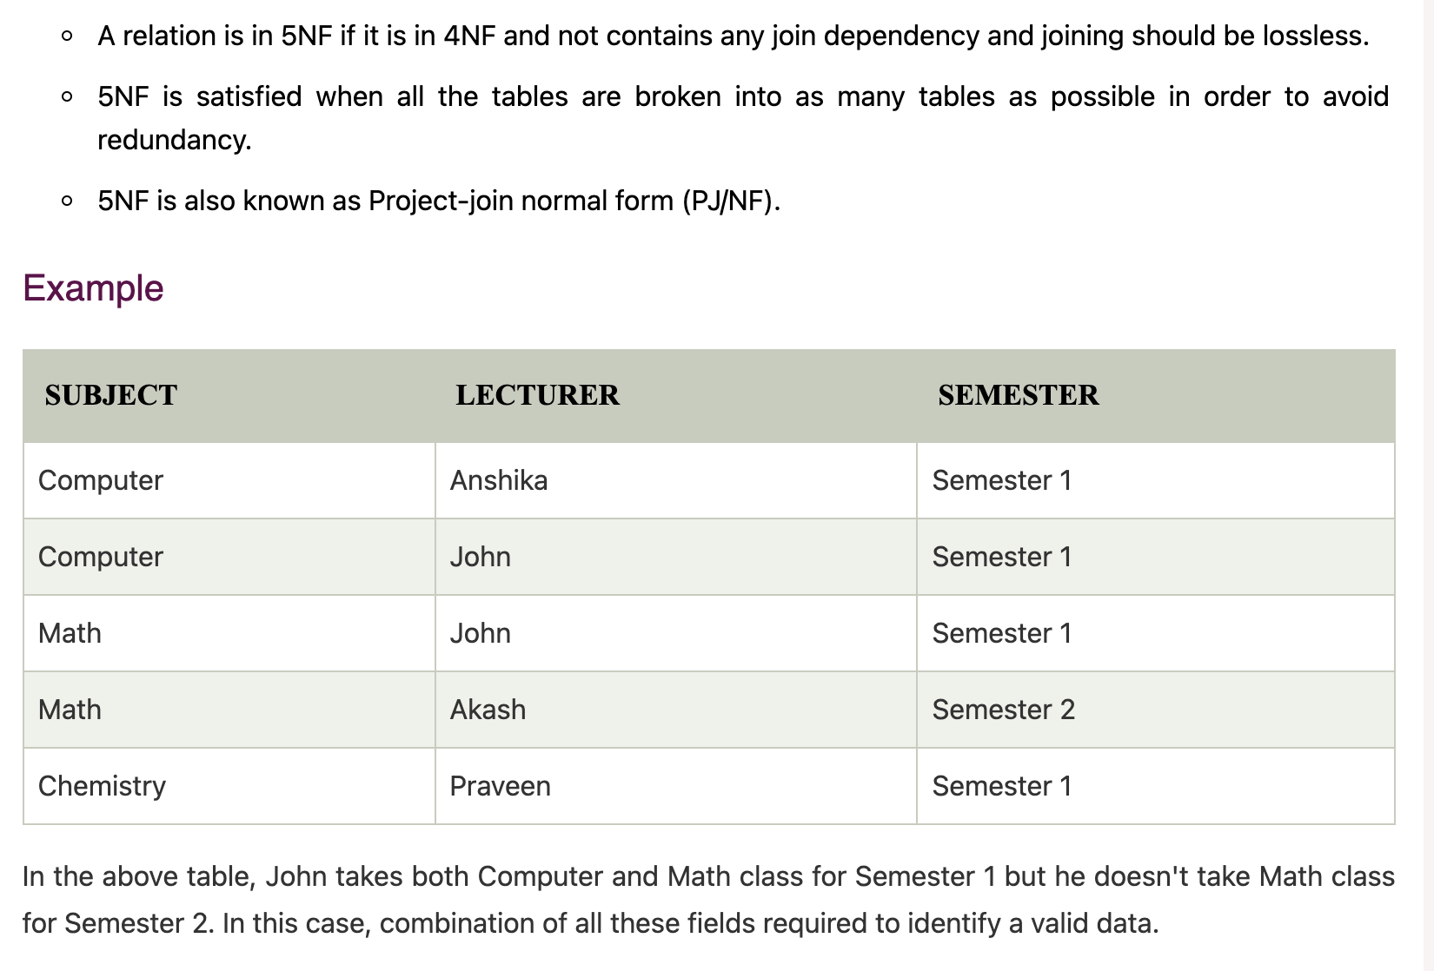
5NF

Slide 22

Suppose we add a new Semester as Semester 3 but do not know about the subject and who will be taking that subject so we leave Lecturer and Subject as NULL. But all three columns together acts as a primary key, so we can't leave other two columns blank.
So to make the above table into 5NF, we can decompose it into three relations P1, P2 & P3:

Slide 23


